Slide 1

Module 10
Working With Text

Slide 2
10.1
Text Files

Slide 3

Text Files
A large number of the files in a typical file system are text files.
Text files only contain text, no formatting features that you might see in a word processing file.
A significant number of commands exist to help users manipulate text files.
There are also features available for the shell to control the output of commands.
  Instead of the output displaying in the terminal window, the output can be redirected into another file or another command.

Slide 4
Viewing Files in the Terminal
The cat command is a useful command that can be used to create and display text files, as well as combining copies of text files.
To display a file using the cat command type the command followed by the filename:
The default output of the cat command is the terminal
The cat command can also be used to redirect file content to other files or input to another command by using redirection characters.
sysadmin@localhost:~/Documents$ cat food.txt
Food is good.

Slide 5
Viewing Files Using a Pager
The cat command is good for viewing small files but is not ideal for large files.
To view larger files, use a pager command.
There are two commonly used pager commands:
  The less command provides advanced paging capability but is not included with all Linux distributions.
  The more command has fewer features than less, but is available in Linux distributions.
The more and less commands allow users to move around a document using keystroke commands.

Slide 6
Pager Movement Commands
To view a file with the less command, pass the filename as an argument:
When viewing a file with the less command, use the H key or Shift + H to display a help screen
Below are the most commonly used movement commands (identical in more and less):
Key Movement
Spacebar Window forward
B Window backward
Enter Line forward
Q Exit
H Help
sysadmin@localhost:~/Documents$ less words

Slide 7
Pager Searching Commands
There are two ways to search in the less command:
  Searching forward or backward from your current position.
  To start a search forward from your current position, use the slash / key then type the text to match and press Enter. For example:
  If no matches forward from your current position can be found, then the last line of the screen will report “Pattern not found“:
  If more than one match can be found by a search, then use the N key to move the next match and use the Shift+N key combination to go to a previous match.
/frog
bullfrog
bullfrog's
bullfrogs
bullheaded

Slide 8
Head and Tail
The head and tail commands are used to display only the first or last few lines of a file.
Passing a number as an option will cause both the head and tail commands to output the specified number of lines instead of default ten.
The -n option can be used to indicate how many lines to output.
The negative value option (i.e., -3) means show -# lines
With the positive value option, if the -n option is used with a number prefixed by the plus sign, then the tail command recognizes this to mean to display the contents starting at the specified line and continuing all the way to the end.

Slide 9
10.2
Command Line Pipes

Slide 10
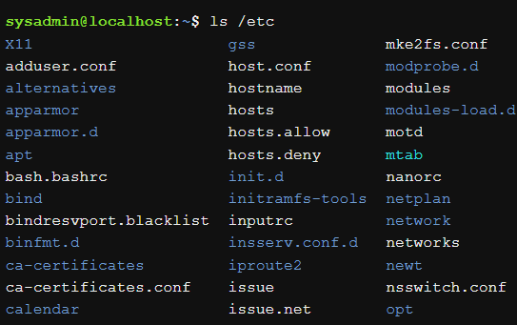
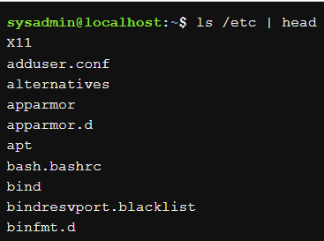
Command Line Pipes
The pipe | character can be used to send the output of one command to another.
The pipe character allows you to utilize the head and tail commands not only on files, but on the output of other commands.
For example, some commands have large amount of output. To more easily view the beginning of the output, pipe it to the head command. The following example displays only the first ten lines:

Slide 11
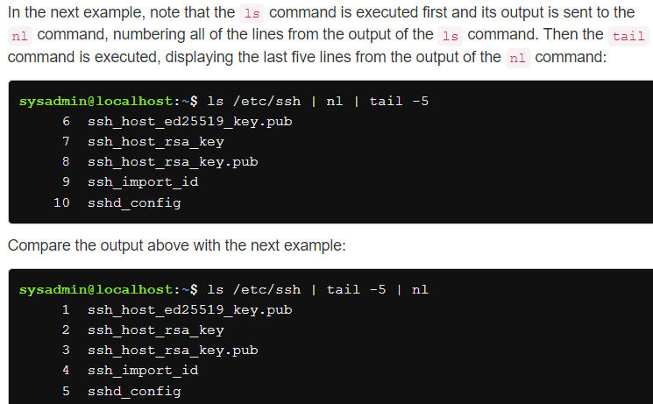
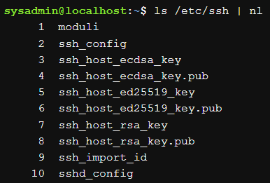
Command Line Pipes – multiple pipes
Multiple pipes can be used consecutively to link multiple commands together. Each command only sees input from the previous command.

Slide 12
10.3
Input/Output Redirection

Slide 13
Input/Output Redirection
Input/Output (I/O) redirection allows for command line information to be passed to different streams.
The streams are:
  STDIN: Standard input, or STDIN, is information entered normally by the user via the keyboard.
  STDOUT: Standard output, or STDOUT, is the normal output of commands.
  STDERR: Standard error, or STDERR, are error messages generated by commands.
I/O redirection allows the user to redirect STDIN so that data comes from a file and STDOUT/STDERR so that output goes to a file.
Redirection is achieved by using the arrow < > characters.

Slide 14
STDOUT
The standard output of a command will display to the screen:
Using the > character, the standard output of a command can be redirected to a file instead:
The example.txt file contains the output of the echo command, which can be viewed with the cat command:
sysadmin@localhost:~$ echo "Line 1"
Line 1
sysadmin@localhost:~$ echo "Line 1" > example.txt
sysadmin@localhost:~$ cat example.txt
Line 1

Slide 15
STDOUT
The single arrow overwrites any contents of an existing file.
It is possible to preserve the contents of an existing file using the >> characters, which append to a file instead of overwriting it.
sysadmin@localhost:~$ echo "New line 1" > example.txt
sysadmin@localhost:~$ cat example.txt
Line 1
sysadmin@localhost:~$ echo "Another line" >> example.txt
sysadmin@localhost:~$ cat example.txt
New line 1
Another line

Slide 16
STDERR
Standard error, or STDERR, is error messages generated by commands. By default, STDERR is displayed in the terminal window where the command is executing. STDERR is also known as stream or channel #2
Using the > character to redirect, stream #1 is assumed by default.
Stream #2 must be specified when redirecting STDERR by placing the number 2 before the arrow > character.
In the example, the 2> indicates that all error messages should be sent to the file error.txt:
sysadmin@localhost:~$ ls /fake
ls: cannot access /fake: No such file or directory
sysadmin@localhost:~$ ls /fake 2> error.txt
sysadmin@localhost:~$ cat error.txt
ls: cannot access /fake: No such file or directory

Slide 17
Redirecting Multiple Streams
It is possible to direct both the STDOUT and STDERR of a command at the same time
Both STDOUT and STDERR can be sent to a file by using the ampersand & character in front of the arrow > character. The &> character set that means both 1> and 2>:
If you don't want STDERR and STDOUT to both go to the same file, they can be redirected to different files by using both > and 2>.
sysadmin@localhost:~$ ls /fake /etc/ppp
ls: cannot access /fake: No such file or directory
/etc/ppp:
ip-down.d ip-up.d
sysadmin@localhost:~$ ls /fake /etc/ppp &> all.txt
sysadmin@localhost:~$ cat all.txt
ls: cannot access /fake: No such file or directory
/etc/ppp:
ip-down.d
ip-up.d
sysadmin@localhost:~$ ls /fake /etc/ppp > example.txt 2> error.txt

Slide 18
STDIN
With most commands, if you want to read data from a file into a command, you can specify the filename as an argument to the command.
However, for some commands, if you don't specify a filename as an argument, they revert to using STDIN to get data (i.e., the cat and tr commands)
Using STDIN, it is possible to tell the shell to get STDIN from a file instead of from the keyboard by using the < character:
sysadmin@localhost:~$ cat example.txt
/etc/ppp:
ip-down.d
ip-up.d
sysadmin@localhost:~$ tr 'a-z' 'A-Z' < example.txt
/ETC/PPP:
IP-DOWN.D
IP-UP.D

Slide 19
Sorting Files or Input

Slide 20
Sorting Files for Input
The sort command can be used to rearrange the lines of files or input in either dictionary or numeric order.
sysadmin@localhost:~$ cat mypasswd
root:x:0:0:root:/root:/bin/bash
daemon:x:1:1:daemon:/usr/sbin:/bin/sh
bin:x:2:2:bin:/bin:/bin/sh
sys:x:3:3:sys:/dev:/bin/sh
sync:x:4:65534:sync:/bin:/bin/sync
sysadmin@localhost:~$ sort mypasswd
bin:x:2:2:bin:/bin:/bin/sh
daemon:x:1:1:daemon:/usr/sbin:/bin/sh
root:x:0:0:root:/root:/bin/bash
sync:x:4:65534:sync:/bin:/bin/sync
sys:x:3:3:sys:/dev:/bin/sh

Slide 21
Fields and Sort Options
The sort command can rearrange the output based on the contents of one or more fields.
Fields are determined by a field delimiter contained on each line.
For example, the following command can be used to sort the third field of the mypasswd file numerically.
  The -t option will allow for another field separator to be specified
  To specify which field to sort by, use the -k option with an argument to indicate the field number
  The -n option is used to perform a numeric sort.
bin:x:2:2:bin:/bbin:x:2:2:bin:/bin:/bin/sh
sysadmin@localhost:~$ sort -t: -n -k3 mypasswd

Slide 22
Viewing File Statistics

Slide 23
Viewing File Statistics
The wc command provides the number of lines, words and bytes (1 byte = 1 character in a text file) for a file, and a total line count if more than one file is specified.
It is also possible to view only specific statistics:
  Use the -l option to show just the number of lines
  The -w option to show just the number of words
  The -c option to show just the number of bytes, or any combination of these options
sysadmin@localhost:~$ wc /etc/passwd /etc/passwd-
35 56 1710 /etc/passwd
34 55 1665 /etc/passwd-
69 111 3375 total

Slide 24
Filtering Files

Slide 25
Filter File Sections
The cut command can extract columns of text from a file or standard input.
The cut command is used for working with delimited files—which contain columns separated by a delimiter.
  By default, the cut command expects its input to be separated by the Tab character, but the -d option can specify alternative delimiters such as the colon or comma.
  The -f option can specify which fields to display.
  The -c option is used to extract columns of text based upon character position.
  In the following example, the first, fifth, sixth and seventh fields from mypasswd database file are displayed:
sysadmin@localhost:~$ cut -d: -f1,5-7 mypasswd

Slide 26
Filter File Contents
The grep command can be used to filter lines in a file or the output of another command that matches a specified pattern:
The grep command can be used with several options to filter lines:
  The -d option can specify alternative delimiters such as the colon or comma
    by default, the cut command expects its input to be separated by the Tab character
  The -f option can specify which fields to display.
  The -c option is used to extract columns of text based upon character position.
sysadmin@localhost:~$ grep --color bash /etc/passwd
root:x:0:0:root:/root:/bin/bash
sysadmin:x:1001:1001:System Administrator,,,,:/home/sysadmin:/bin/bash

Slide 27
Basic Regular Expressions

Slide 28
Basic Regular Expressions
Regular expressions, also referred to as regex, are a collection of normal and special characters that are used to find simple or complex patterns, respectively, in files.
Normal characters are alphanumeric characters which match themselves.
  For example, an a character would match an a
Special characters have special meanings when used within patterns by commands like the grep command.
There are both Basic Regular Expressions (available to a wide variety of Linux commands) and Extended Regular Expressions (available to more advanced Linux commands).

Slide 29
Basic Regular Expressions
Basic Regular Expressions include the following:
Character | Matches
. | Any single character
[ ] | A list or range of characters to match one character. If the first character is the caret ^, it means any character not in the list
* | The previous character repeated zero or more times
^ | If the first character in the pattern, the pattern must be at the beginning of the line to match, otherwise just a literal ^
$ | If the last character in the pattern, the pattern must be at the end of the line to match, otherwise just a literal $
The grep command is just one of the many commands that support regular expressions. Some other commands include the more and less commands.

Slide 30
Basic Regular Expressions - The . Character
The . character matches any character except for the new line character.
The pattern r..f would find any line that contained the letter r followed by exactly two characters and then the letter f:
The . character can be used any number of times. To find all words that have at least four characters, the following pattern can be used:
sysadmin@localhost:~/Documents$ grep 'r..f' red.txt
reef
roof
sysadmin@localhost:~/Documents$ grep '....' red.txt
reef
reeed
roof

Slide 31
Basic Regular Expressions - The [ ] Character
In some cases, you want to specify exactly which characters you want to match, such as a lower-case alphabet character or a number character.
The square brackets [] match a single character from the list or range of possible characters contained within the brackets:
Each possible character can be listed out [abcd] or provided as a range [a-d], as long as the range is in the correct order.
To match a character that is not one of the listed characters, start the [] set with a ^ symbol.
sysadmin@localhost:~/Documents$ grep '[0-9]' profile.txt
I am 37 years old.
3121991
I have 2 dogs.
123456789101112

Slide 32
Basic Regular Expressions - The * Character
The asterisk * character is used to match zero or more occurrences of a character or pattern preceding it.
For example, e* would match zero or more occurrences of the letter e:
It is also possible to match zero or more occurrences of a list of characters by utilizing square brackets. the following example matches zero or more occurrences of the o character or the e character:
To make the asterisk * character useful, create a pattern which includes more than just the one character preceding it (i.e., ee*).
sysadmin@localhost:~/Documents$ grep 're*d' red.txt
red
reeed
rd
sysadmin@localhost:~/Documents$ grep 'r[oe]*d' red.txt

Slide 33
Basic Regular Expressions - Anchor Characters
When performing a pattern match, the match could occur anywhere on the line.
Anchor characters specify whether the match occurs at the beginning of the line or the end of the line.
The circumflex ^ character is used to ensure that a pattern appears at the beginning of the line:
The second anchor character, $, can be used to ensure a pattern appears at the end of the line:
sysadmin@localhost:~/Documents$ grep '^root' passwd
root:x:0:0:root:/root:/bin/bash
sysadmin@localhost:~/Documents$ grep 'r$' alpha-first.txt
B is for Bear
F is for Flower

Slide 34
Basic Regular Expressions - The \ Character
Use the backslash character \ to match a character that happens to be a special Regular Expression character:
In the example below, the pattern re* matches an r (followed by zero or more of the letter e):
To look for an actual asterisk * character, place a backslash \ character before the * character:
sysadmin@localhost:~/Documents$ grep 're*' newhome.txt
**Beware** of the ghost in the bedroom.
sysadmin@localhost:~/Documents$ grep 're\*' newhome.txt
**Beware** of the ghost in the bedroom.

Slide 35
Extended Regular Expressions
The use of extended regular expressions often requires a special option be provided to the command to recognize them.
  The -E option to the grep command can understand extended regular expressions.
The following regular expressions are considered extended:
Character | Matches
? | Matches previous character zero or one time, so it is an optional character
+ | Matches previous character repeated one or more times
| | Alternation or like a logical or operator

Slide 36
Extended Regular Expressions
Use the ? character to match colo followed by zero or one u character followed by an r character:
Use the + character to match one or more e characters:
Use the | character to match either gray or grey:
sysadmin@localhost:~/Documents$ grep -E 'colou?r' spelling.txt
American English: Do you consider gray to be a color or a shade?
British English: Do you consider grey to be a colour or a shade?
sysadmin@localhost:~/Documents$ grep -E 'e+' red.txt
red
reef
reeed
sysadmin@localhost:~/Documents$ grep -E 'gray|grey' spelling.txt
American English: Do you consider gray to be a color or a shade?
British English: Do you consider grey to be a colour or a shade?

